Slide 1
Viral infection in newborn
Dr Phu Truong

Slide 2
Congenital, Perinatal, and Neonatal Viral Infections
Intrauterine Viral Infections
Rubella
Cytomegalovirus (CMV)
Parvovirus B19
Varicella-Zoster (VZV)
Enteroviruses
HIV
HTLV-1
Hepatitis C
Hepatitis B
Lassa Fever
Japanese Encephalitis
Perinatal and Neonatal Infections
Human Herpes Simplex
VZV
Enteroviruses
HIV
Hepatitis B
Hepatitis C
HTLV-1

Slide 3
  TORCH
    T: toxoplamosis
    O: others
    R: rubella
    C: cytomegalo virus
    H: herpes simlex virus

Slide 4
Cytomegalovirus

Slide 5
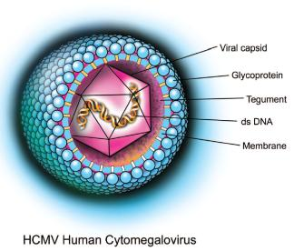
CMV
Double-stranded & enveloped DNA
Member of the herpesvirus family
Only in human:
  Saliva
  Urine
  Genital secretion
  Breast milk
  Blood/blood products

Slide 6
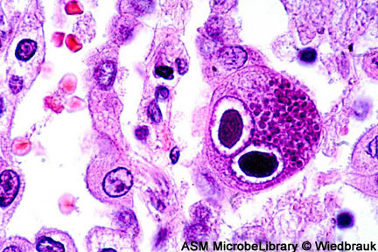
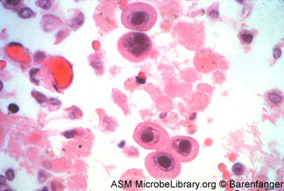
Infected cells: epithelial cells & lymphocytes
Abundant cytoplasm
Intranulear & cytoplasmic basophillic inclusions
(→) : typical owl’s eye
Notes:
Fgdg

Slide 7
Congenital infection
Early manifestation: multiple organs & high risk of mortality
Second early manifestation: without life-threatening complications
  Petechiae/purpura (79%)
  Hepatosplenomegaly (74%)
  Jaudice (63%)
  Prematurity
  “blueberry muffin spot”: extramedullary hematopoiesis,
  Lab: elevated hepatic transaminase, bilirubin levels, anemia, thrombocytopenia
  IUGR
  Microcephaly (48%) ± calcification (periventricular area)
  Chorioretinitis (10-15%)
  CNS abnormalities: ventricular dilatation, cortical atrophy, hearing loss, mental retardation…

Slide 8
Perinatal infection
From:
  Intrapartum
  Breast milk
  Infected blood/blood products
  Nosocomial infections
  The incubation period: 4 – 12 wks
  Common sign: Hearing loss

Slide 9
Diagnosis
Isolation of CMV from the urine or saliva of the neonate.
Presence of CMV IgM from the blood of the neonate.
Detection of Cytomegalic Inclusion bodies from affected tissue (rarely used)
The sensitivity of PCR test is unknown in neonatal CMV.

Slide 10
Gold standard: urine viral cultures
  (kidney is a principal site of viral replication)
  Congenital infections: < 3 weeks
  Perinatal infections: > 4 weeks
Diagnosis of Cytomegalovirus:
Urine viral culture
Hearing evaluation
Ultrasound or computed tomograph of brain
Eye examination

Slide 11
Treatment
Gancyclovir:
  Neonates with life-threatening symptomatic disease, including intractable thrombocytopenia, pneumonia, or hepatic failure.
  Do not recommend for asymptomatic infants found to be congenitally infected → followed carefully for the development of sensorineural hearing loss.

Slide 12
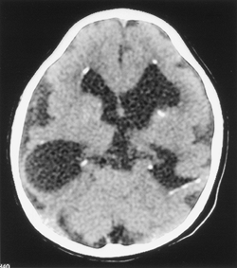

Slide 13
Herpes Simplex Virus

Slide 14
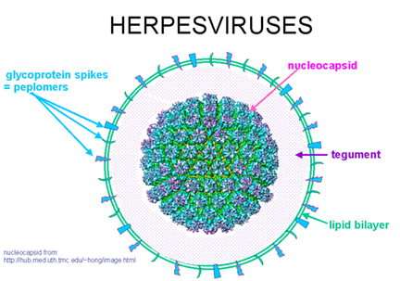
a double-stranded, enveloped, DNA virus.
Two types: HSV-1 & HSV-2, belong to the family Herpesviridae.

Slide 15
Epidemiology
Depending on the population surveyed: 10 – 15% of women, may be higher.
HSV2 75% - 80% in neonates.
Tranmission: intrapartum >>>
The current practice is such that exposure to herpesvirus can never be avoided.
pediatricians must be vigilant to the various manifestations of neonatal herpes that usually present in the first month of life.

Slide 16
Presentation
1. Mucocutaneous Disease: 50%
skin, eye, mouth
  Groups of vesicles; a large percentage of untreated cases progress to disseminated disease
  Diagnosis: Direct immunofluorescence or viral culture of vesicles
2. Encephalitis:
Presents with lethargy, seizures at 2 to 3 weeks of age
Cerebrospinal fluid reveals 100 to 200 white cells with lymphocytic predominance
- Diagnosis: Viral culture (positive in <20%)
PCR of cerebrospinal fluid
EEG: temporal lobe spikes in 80%

Slide 17
3. Pneumonia
Vesicles typically not present
Progressive pulmonary infiltrates
Negative bacterial cultures
Elevation of liver function tests
4. Disseminated disease
Fever, lethargy
Negative bacterial cultures
Elevated liver function tests, coagulopathy
Vesicles typically absent
Diagnosis: viral cultures, PCR of blood, cerebrospinal fluid

Slide 18
Diagnosis
* Even in neonates with only mucocutaneous disease, the rate of a positive serum PCR can be greater than 50%.
Direct immunofluorescent antibodies (DFA), viral culture of vesicles
Serum, CSF PCR (gold standard*)
EEG (80% show temporal lobe spikes)

Slide 19
Management
Acyclovir:
  If there is any suspicion regarding whether a skin lesion is a vesicle, empiric acyclovir should be started while appropriate studies are obtained.
  IV acyclovir: 60 mg/kg/day : 3 doses
  Duration: 14 days (mucocutaneous disease)
  21 days (disseminated disease/ encephalitis)
controlling seizures and coagulopathy
Prevention:
  for recurrent cutaneous herpes on long-term
  oral acyclovir: 300 mg/m²/dose x 2 -3 times/daily for 6 months.

Slide 20
Rubella

Slide 21
History
From Latin meaning "little red"
1881 Rubella accepted as a distinct disease
1941 Associated with congenital disease (Gregg)
1961 Rubella virus first isolated
1967 Serological tests available
1969 Rubella vaccines available

Slide 22

RNA – enveloped virus
Member of the togavirus
family
One antigenic type
Rapidly inactivated by
chemical agents, ultraviolet
light, low pH, and heat
Spread by respiratory droplets.

Slide 23
Epidemiology
In the prevaccination era, 80% of women were already infected by childbearing age.
Most cases of congenital rubella are the result of primary maternal disease during pregnancy.
The risk for fetal infection is highest during early gestation, although the most severe manifestations occur when infection is in the last trimester.

Slide 24
Presentation
maculopapular rash
lymphadenopathy
fever
arthropathy (up to 60% of cases)

Slide 25
Risks of rubella infection during pregnancy
Preconception minimal risk
0-12 weeks 100% risk of fetus being congenitally infected
resulting in major congenital abnormalities.
Spontaneous abortion occurs in 20% of cases.
13-16 weeks deafness and retinopathy 15%
after 16 weeks normal development, slight risk of deafness and retinopathy

Slide 26
Congenital Rubella Syndrome
Deafness
Cataracts
Heart defects: PDA, PS
Microcephaly
Mental retardation
Bone alterations
Liver and spleen damage
Many children may be asymptomatic at birth but develop manifestations later in life.

Slide 27
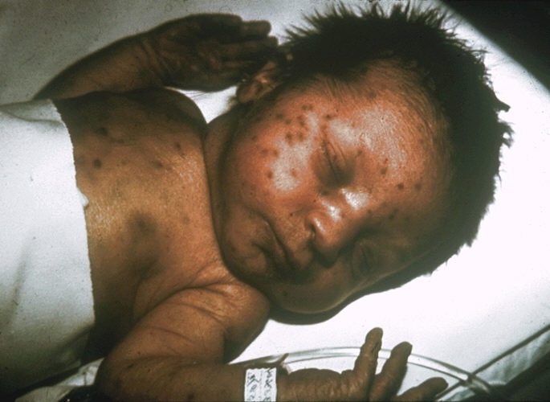

Slide 28
Virus is readily excreted from throat, urine, and CSF, but viral isolation of rubella is difficult and usually not achieved.
* Presence of typical rubella defects
* Virus – specific IgM or a four-fold rise in IgG or PCR (+)

Slide 29
Management
At the present time, there is no treatment for infants with congenital rubella.
Infection usually confers lifelong immunity, but reinfection is occasionally detected serologically after the natural disease or a vaccination upon reexposure to the virus and rarely results in clinical disease.

Slide 30
Prevention
Antenatal screening
All pregnant women attending antenatal clinics are tested for immune status against rubella.
Non-immune women are offered rubella vaccination in the immediate post partum period.
Women who decide to be pregnant should make vaccination before 3 ms

Slide 31
Vaccination of Women of Childbearing Age
Ask if pregnant or likely to become so in next 4 weeks
Exclude those who say "yes"
For others
  explain theoretical risks
  vaccinate

Slide 32
Rubella Vaccine
Composition Live virus (RA 27/3 strain)
Efficacy 95% (Range, 90%-97%)
Duration of
Immunity Lifelong
Schedule At least 1 dose
Should be administered with measles and mumps as MMR or with measles, mumps and varicella as MMRV

Slide 33
Measles Mumps Rubella Vaccine
12 -15 months is the recommended and minimum age (more effective at 15 months)
MMR given before 12 months should not be counted as a valid dose
2nd dose at 4-6 years

Slide 34
Varicella-Zoster Virus

Slide 35
Member of the herpesvirus family.
It commonly causes chicken-pox in children and both shingle and posherpetic neuralgia in adults and rarely in children.
Varicella-zoster virus is known by many names, including: chickenpox virus, varicella virus, zoster virus, and human herpes virus type 3 (HHV-3).

Slide 36
Epidemiology
Transmission: through respiratory droplets or contact with vesicular lesions.
Individuals with chicken pox are contagious from 1-2 days before & 5 days after onset of rash, no longer contagious when all lesions have dried & crusted over.
Varicella occurs in approximately 25% of newborns whose mother developed varicella within the peripartum period.
The incubation period for primary disease extends from 10 – 21 days → when the rash develops in the newborn within 10 days, it is resumed to result from in utero tranmission.

Slide 37
Presentation
1. Congenital varicella syndrome:
- Cicatricial skin lesions, hypoplasia of limbs, occular defects, CNS abnormalities, IUGR, early death.
- Occurrence of syndrome is from 7 – 20 weeks of gestation.
2. Zoster:
- Uncommon, self-limiting.
3. Postnatal varicella: is generally a mild disease.

Slide 38
Diagnosis
* Made on basic of clinical findings & maternal history.
* Culture of vesicular fluid (not optimal)/rising IgG

Slide 39
Management
CVS: antiviral therapy is not indicated.
Perinatal varicella: Acyclovir 60 mg/kg/day : 3
VZIG: may be prophylactic value when administered within 72 hours of exposure
  The dose for newborns: 125 UI (IM)
  If maternal disease began < 5 days before delivery or within 2 days pospartum.
  May consider acyclovir in addition.
  The infant should be isolated from the mother until she is no longer infectious.

Slide 40
Vaccination
For women who are not immune to varicella
They shoulds not receive the vaccine if they are pregnant or in the 3 months before pregnancy.
Women who acquire primary varicella during pregnancy should be treated with acyclovir for their own health as well as to prevent fetal infection.

Slide 41
Parvovirus

Slide 42
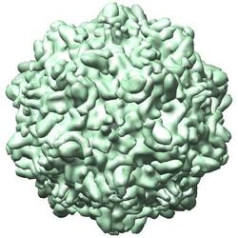
Small, unenveloped single-stranded DNA virus
Parvovirus B19 causes an infection in humans only
.

Slide 43
Epidemiology
Transmission: contact with respiratory secretions, blood/blood products, vertical transmission.
Infection is very common, 60-70% of the population is eventually infected.
Women who are parents of young children, elementary school teachers, or child care workers may be at greatest risk for exposure.
50% of women of childbearing age are susceptible to infection.
The rate of fetal infection in women seroconvert during pregnant is unknown

Slide 44
Presentation
In children
In adults
“slapped cheek” rash of erythema infectiosum (Fifth disease)
Fever
Associated symptoms: myalgias, upper respiratory/gastrointestinal symptoms…
Arthralgias & arthritis are more common (peripheral joints, symmetrically).
Rash

Slide 45
Congenital Parvovirus Infection
Cause of hydrops fetalis; severe anemia, congestive heart failure, generalized oedema and fetal death
Maternal primary infection → transplacental transfer of B19 virus → infection of red blood cell precursors → arrested red blood cell production → severe anemia → Congestive heart failure → Edema.
Risk of fetal death highest when infection occurs during the second trimester of pregnancy (12%).
Minimal risk to the fetus if infection occurred during the first or third trimesters of pregnancy.
Maternal infection during pregnancy does not warrant termination of pregnancy but should be followed carefully.

Slide 46
Diagnosis
Parvovirus B19 will not grow in standard tissue cultures because humans are the only host.
    IgM (+)/persistent IgG
    PCR (+)

Slide 47
Management
Treatment is generally supportive.
IVIG has a limited succes in patients with severe hematologic disorders.
There are no recommendations for use of IVIG in pregnancy.
Intrauterine blood transfusion may be considered if the fetal hemoglobin < 8g/dl.

Slide 48
Prevention
Determination of susceptibility of acute infection by serum IgG & IgM & PCR.
For susceptible/acute infected women, serial fetal ultrasonography to monitor fetal growth & the possible evolution of hydrops.
Determination of fetal IgM/DNA PCR by percutaneous umblilical blood sampling.

Slide 49
Human Immunodeficiency Virus

Slide 50
Enveloped, RNA retrovirus
The virus binds to the host CD4⁺ cells.
3 genes: gag, pol, env
At least 6 additional genes:
  Gp120: necessary for the binding of virus to the target cells.
  p24: major core protein

Slide 51
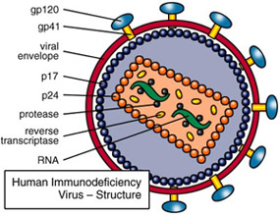

Slide 52
Epidemiology
A pregnant woman with untreated HIV: has an approximately 20% to 25% chance of giving birth to an infected infant.
HIV can be transmitted transplacentally:
  at any stage of the pregnancy
  at the time of delivery (most)
  during the postnatal period through breast-feeding
HIV antibody crosses the placenta →100% of infants born to HIV-positive women are HIV antibody positive. Maternal HIV antibody can persist in the child for up to 18 months.

Slide 53
Presentation
Varied
  always be considered in a child who suddenly develops severe interstitial pneumonia and respiratory failure.
  A subset of children with HIV infection remain relatively well for years, with the only signs being isolated developmental delay or thrombocytopenia.
Some children present in the first year of life:
  severe thrush
  organomegaly
  failure to thrive
  Pneumocystis jiroveci (formerly P. carinii)

Slide 54
Diagnosis
<18ms:
AIDS-defining illness + possitive anibody
PCR
p24 antigen assay
In vitro cell culture of mononuclear cells.

Slide 55
Management
Antiviral therapy
At presence, there is no cure for HIV infection, but the goal of AVT is to suppress the HIV viral load to nondetectable & to maintain or reconstitute CD4⁺ cell numbers to > 25%

Slide 56
NRTIs (nucleoside/nucleotide analog reverse transcriptase inhibitors): Zidovudine, AZT…prevent viral RNA from being reverse transcribed to DNA.
NNRTIs (non-nucleoside/nucleotide analog reverse transcriptase inhibitors): nevirapine
PIs (Protease inhibitors): prevent processing of viral protein
2 NRTIs + PIs/NNRTIs → HAART

Slide 57
- Current standard of care in the United States is to suppress maternal viral load to nondetectable during pregnancy (and after pregnancy to optimize the maternal health care.
The rate of transmission is <2% for women with receiving antiretroviral therapy.

Slide 58
  THANK YOU FOR YOUR ATTENTION!

